Slide 1

Modification of Quorum Sensing
Phenotypes and Related Pathways of Pseudomonas aeruginosa
Ava Karanjia
Dr. Heather Bean
Arizona State University
April 13, 2019

Slide 2
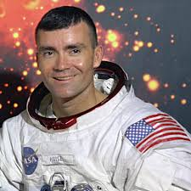
Astronaut Fred Haise Jr.
Notes:
Astronaut aboard the Apollo 13 mission, contracted a Pseudomonas aeruginosa infection in his kidneys during the Apollo 13 mission
Oxygen tank exploded on board, astronauts aborted the mission and tried to go home, Fred Haise got a kidney infection with this bacteria

Slide 3


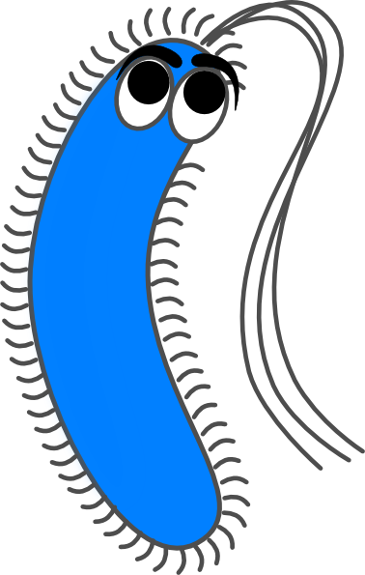
Active
Immune System
Decreased Possibility for an Infection
Normal Bacteria

Slide 4
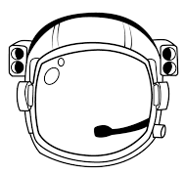


Suppressed Immune System
Increased
Possibility for an Infection
Stressed
Bacteria

Slide 5

Notes:
But the typical patient infected by this bacteria looks like this little girl, so this issue can affect astronauts but also lots of people here on earth
Isolates or strains collected for research purposes typically come from people like her

Slide 6
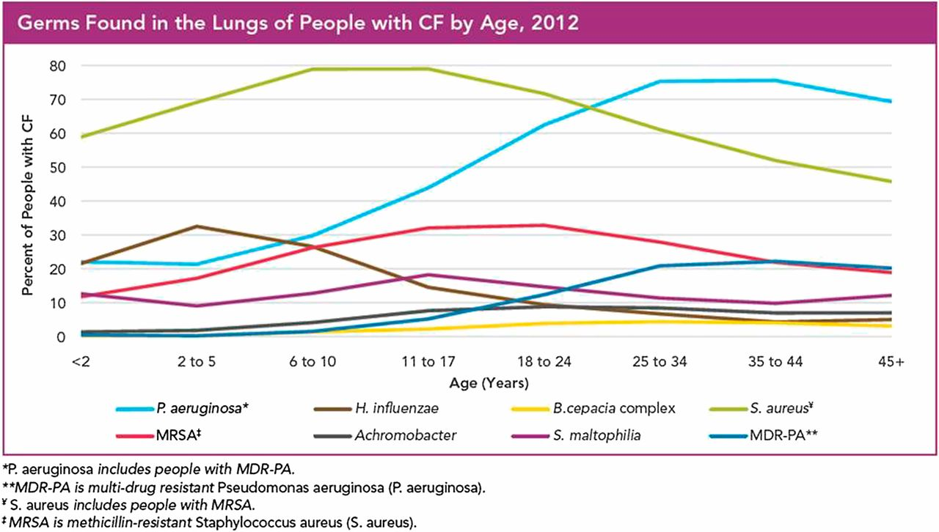
Paranjape, S. M.; Mogayzel, P. J. (2014) Pediatrics in Review, 35 (5), 194–205.

Slide 7
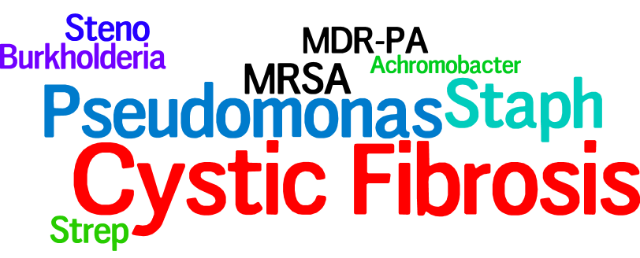
Paranjape, S. M.; Mogayzel, P. J. (2014) Pediatrics in Review, 35 (5), 194–205.

Slide 8
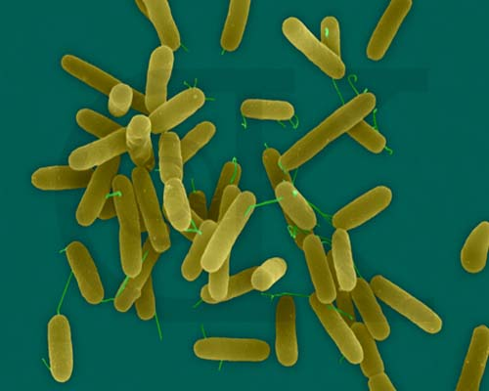


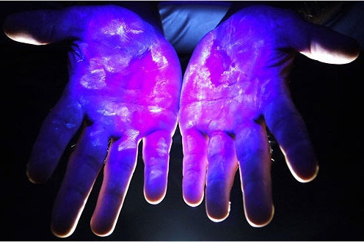
Pseudomonas aeruginosa
www.pbase.com
Pseudomonas.com
shelbycountyswcd.org
nytimes.com

Slide 9
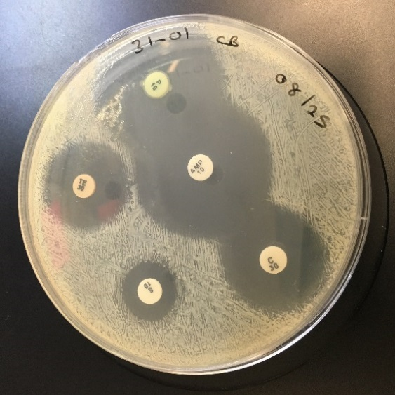
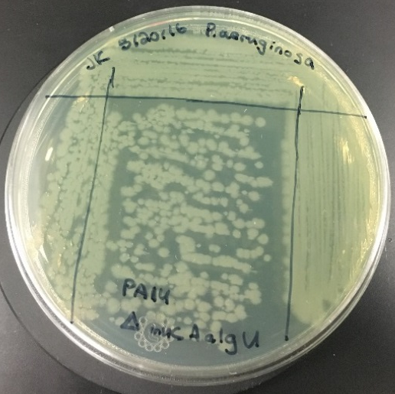
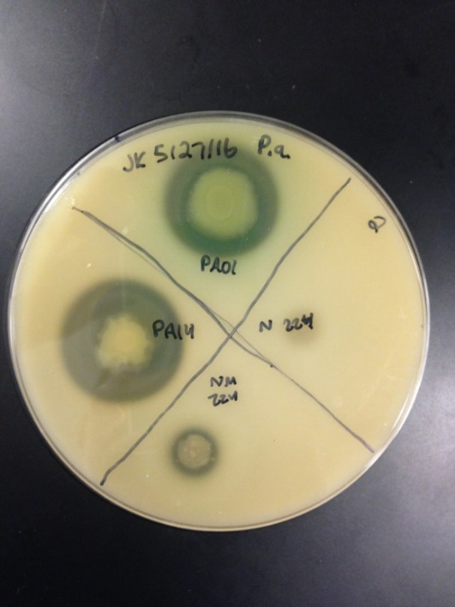
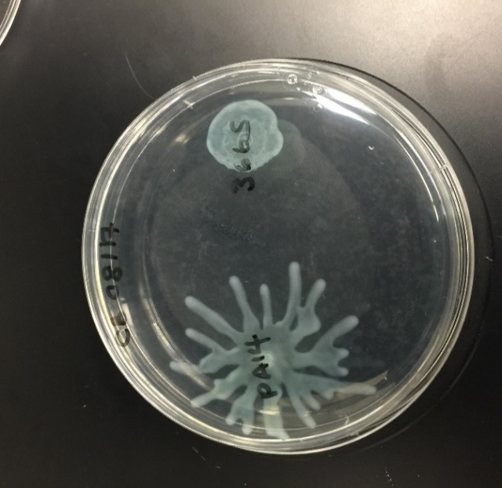
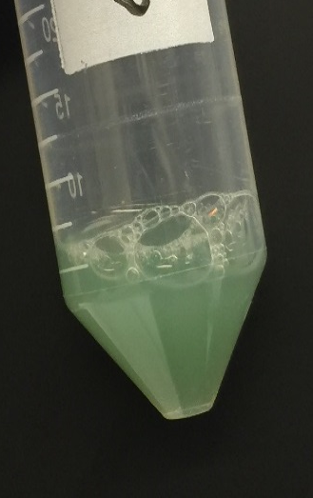
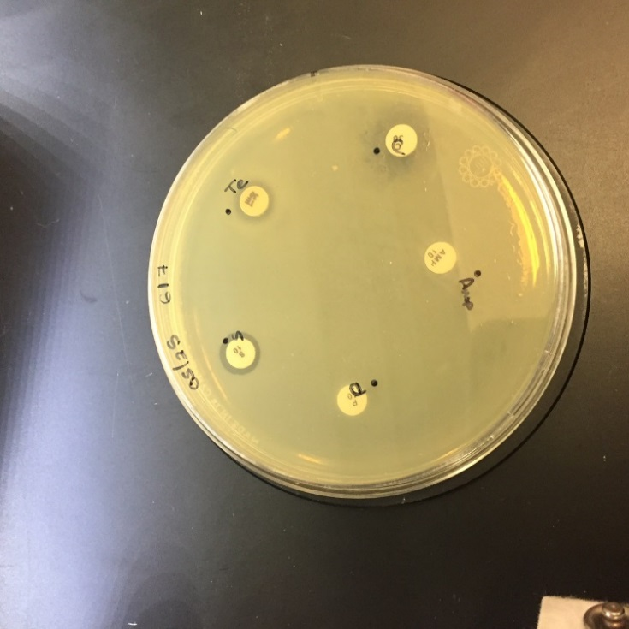
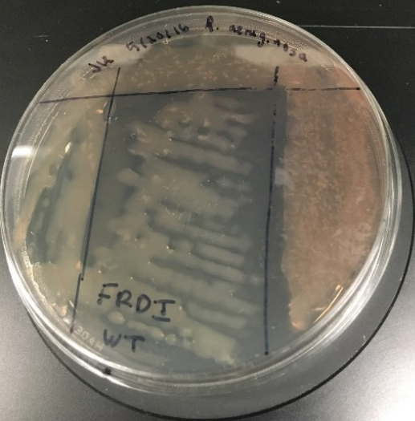

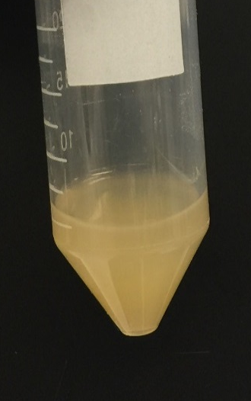
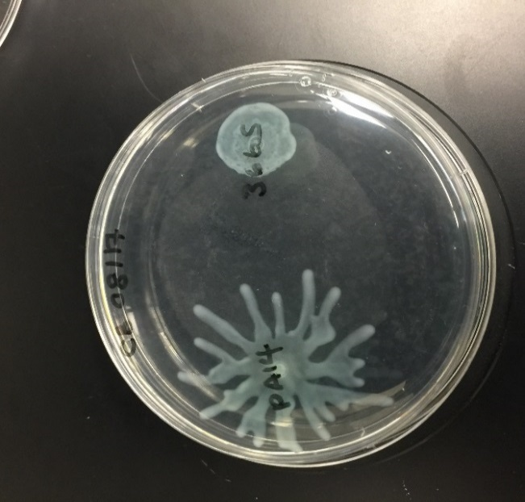
P. aeruginosa adapts in the lung
Antibiotic resistance
Mucoidy
Motility
Protease
Pyocyanin
LOSS OF FUNCTION

Slide 10
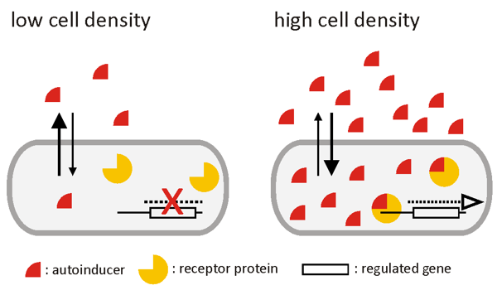
What is Quorum Sensing (QS)?
Individual behaviors
Group behaviors
Schaechter.asmblog.org

Slide 11
QS in Pseudomonas aeruginosa
lasI
rhlI
lasR
rhlR
Protease
Pyocyanin
Rhamnolipids
Protease
Notes:
Quantify exoproduct production

Slide 12
QS-related virulence factor production decreases over time
Notes:
More specified slide title, arrows within the diagram

Slide 13
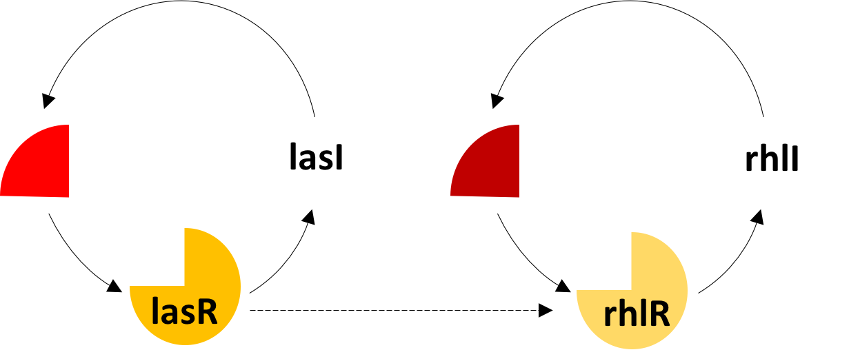
Creation of Deletion Mutants
Phenotypic changes in result of Δ, ΔΔ in receptor mutant strains

Slide 14
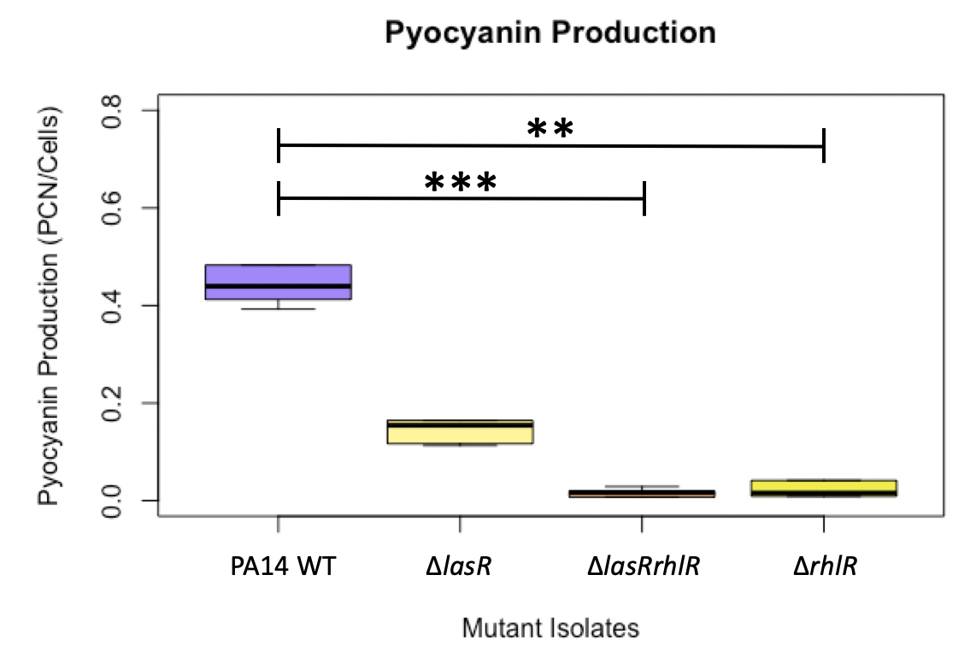
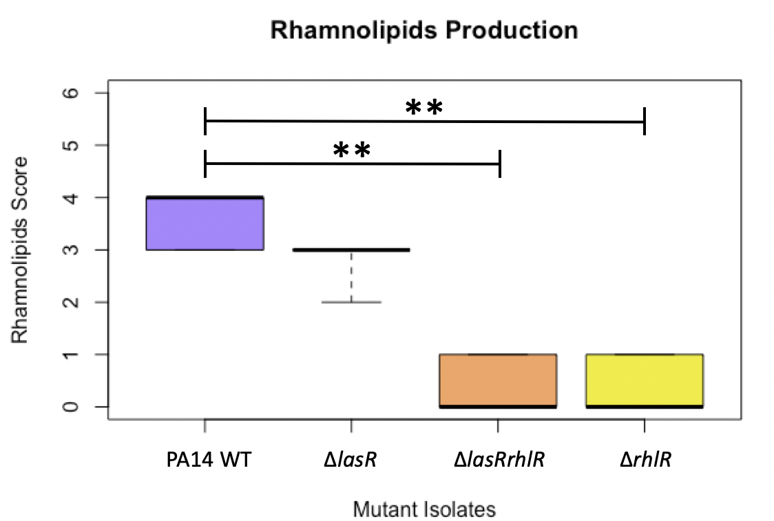
In-Frame Deletion Mutants: QS Regulators

Slide 15
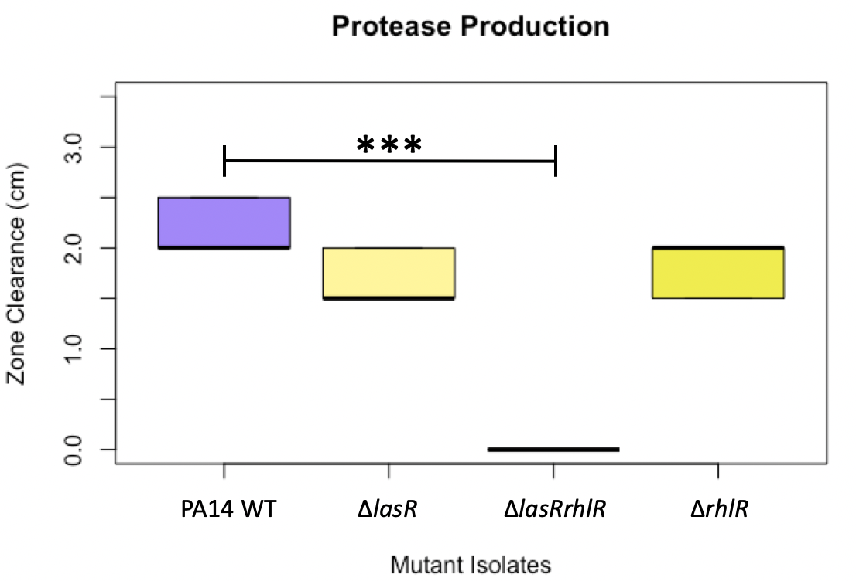
In-Frame Deletion Mutants: QS Regulators

Slide 16
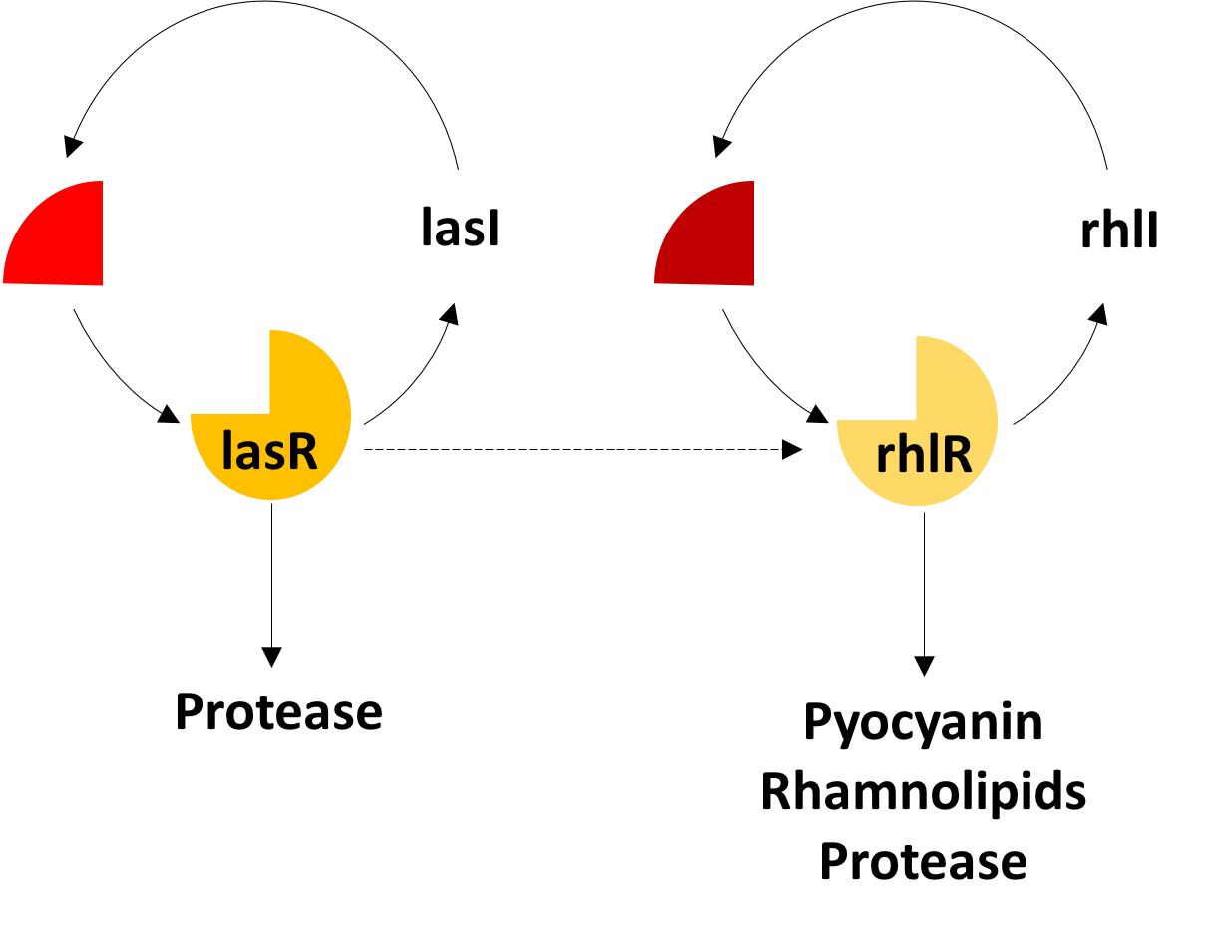
Future Directions
Quantify signaling molecules
Phenotypic changes in result of Δ, ΔΔ, ΔΔΔ, ΔΔΔΔ mutant strains

Slide 17


Acknowledgements
Bean Lab, ASU:
Dr. Heather D. Bean
Trenton Davis
Charity Bhebhe, Sarah West
Support:
Cystic Fibrosis Foundation, CF Isolate Core at Seattle Children’s Research Institute, ASU SOLUR Program, NASA/ASU Space Grant Program

Slide 18
Pseudomonas.com
Questions?
www.pbase.com
shelbycountyswcd.org
nytimes.com

